Slide 1
Genetically Modified Foods
By Kayla Slater

Slide 2
Overview
Review
Learning Objectives
Myths vs. Fact
The Evidence
Top 10 GM Foods
The use of Biotechnology
Regulation/Labeling
Safety
Testing
Consumer Response
Corporation Response
Marketing vs. Evidence
Current News
Video
Are GMO’s safe to eat?
Should GMO’s be labeled?
What do you think?
Conclusions
Questions
Quiz

Slide 3
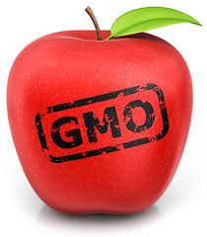
Review
Facts and Statistics about GMOs
The World’s Biggest GMO lovers (U.S., Brazil, Argentina)
What GMOs are and the process
Pros of GMOs and supporters
Cons of GMOs and opponents

Slide 4
Learning Objectives
After this presentation, students will be able to:
Know at least one fact about GMOs
Know the regulation/labeling laws and who regulates GMOs
Be able to make an informed and educated decision about the use/labeling of GMOs

Slide 5
Myth vs. Fact
Myth
FACT
GMOs are safe and have no long-term potential health risks
The use of GMOs is a recent technology development
Potential health risks are based on human studies
GMOs are considered safe by the FDA, but the long-term affects of GMOs are not known
The use of biotechnology has been used since ancient times and crops have been genetically modified for at least 20 years
Potential risks of short-term health affects have only been studied in laboratory and animal studies

Slide 6
The Evidence
Studies – Many animal studies show harmful health affects
May lead to potential health risks, but more adequate testing is needed to understand safety of GMOs and the long-term affects
Notes:
Studies:
1. rat study – grew tumors from Monsato’s corn feed, bad study?
2. Other animal studies:
- Bt toxin – toxic or allergenic
- round-up – contamination
- Gm soy in mice – distrurbed liver, pancreas, and testes
- GM maize in rats – liver and kidney function

Slide 7
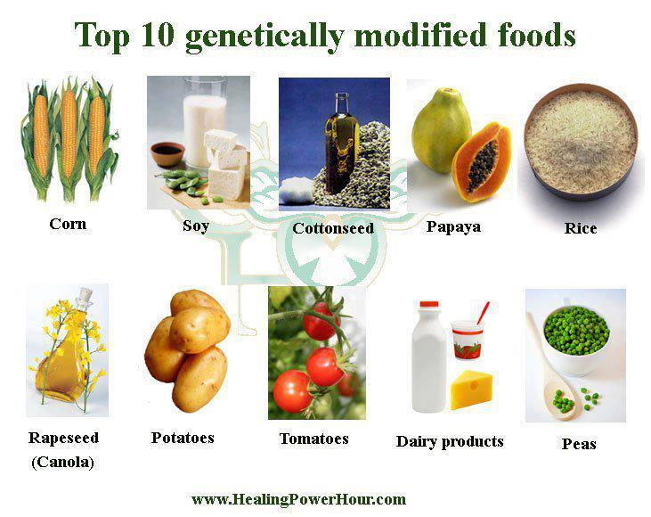
Top 10 GM Foods
Soy
Corn
Canola Oil
Cotton (cotton oil)
Milk
Sugar beets
Aspartame
Zucchini
Yellow Squash
Papaya

Slide 8
The use of Biotechnology
Fermentation – 6, 000 BC by Babylonians and Egyptians
cross-breeding/hybridization
1954 – DNA was discovered
1973 – recombinant DNA techniques began
Insulin
HGH
Hepatitis B vaccine
Herbicide-resistant crops/insect-resistant crops

Slide 9
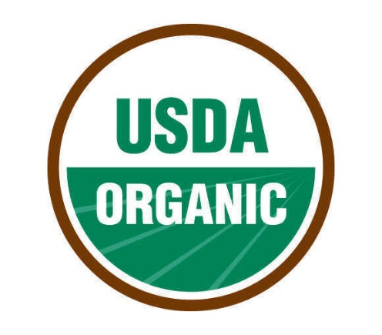
Regulation/Labeling
Currently, the U.S. has no labeling laws, but many other countries and U.S. states have banned or passed laws to require labeling
FDA
USDA
EPA

Slide 10
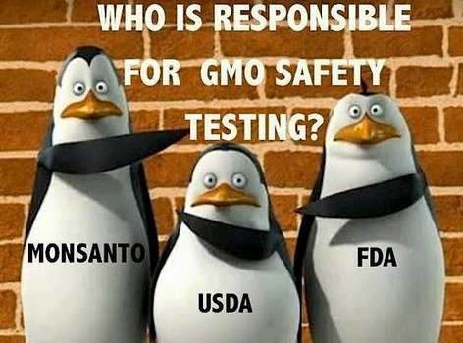
Safety
Food, Drug, and Cosmetic Act
Safety assessment by the developer of crop
FDA evaluates the safety assessment

Slide 11
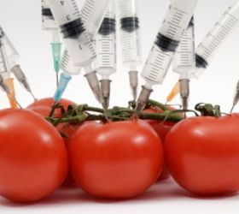
Testing
Substantial equivalence
Quantitative testing
Qualitative testing

Slide 12
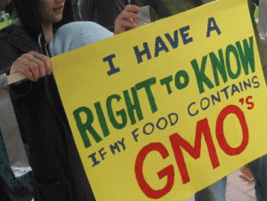
Consumer Response
Risks are socially constructed
Public lacks trust in food industry and corporations
Polls show that the public wants labeling of GMOs

Slide 13
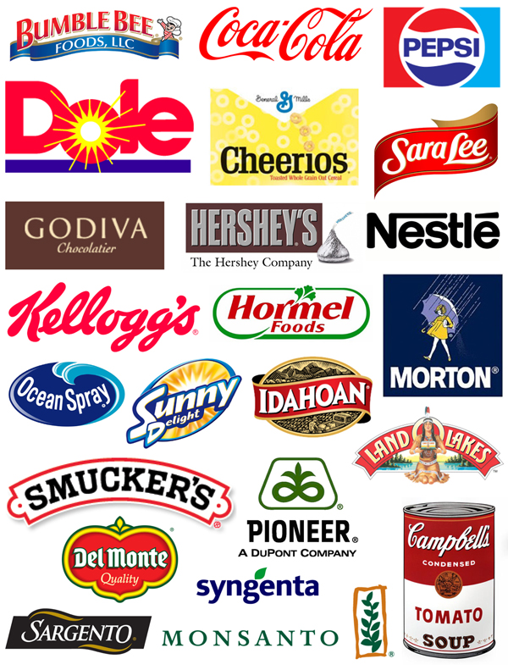
Producer/Corporation Response
Do not want to label GMOs
Large corporations
Why?
Liability
Traceability
Increases cost

Slide 14
Marketing vs. Evidence Debate
Producers are not responding to the concerns of the consumer
More about profit than consumer’s welfare
Evidence may being held back from the public
“Biological relevance”

Slide 15
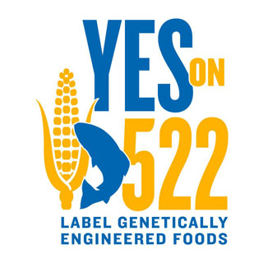
Current News
Washington State held an election on the mandatory labeling of GMOs
The bill did not pass
Large corporations such as Kellog’s and Monsato prevented the bill from passing

Slide 16
Video
Colbert Report on GMOs

Slide 17
Are GMO’s safe to eat?
Supporters vs. Opponents

Slide 18
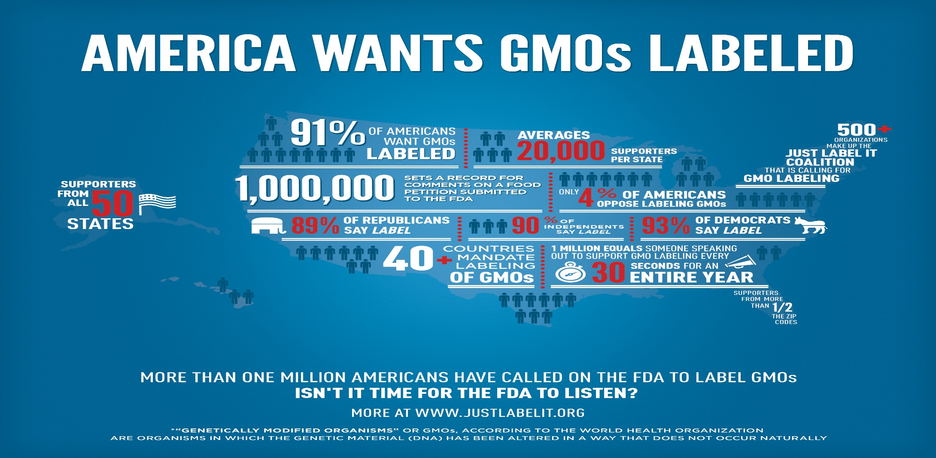
Should GMO’s be labeled?

Slide 19
What do you think?
Are you pro-GMO?
Are you anti-GMO?
Should labeling of GMOs be required by law in the U.S.?

Slide 20
Conclusions
We must understand what the evidence shows
The top GM foods are ingredients used in many common foods
The use of biotechnology has been around for centuries
FDA regulates the safety of GMOs and GMOs are tested before marketed, but no labeling laws are required
Consumer/Corporation Response
Current news
Views of supporters and opponents

Slide 21
Questions?

Slide 22
Presentation Quiz
1. List one fact about GMOs.
2. Who regulates GMOs and are GMOs required to be labeled?
3. Do you think GMOs should be labeled based on the information in this presentation? Explain.

Slide 23
References
Antoniou, M., Robinson, C., & Fagan, J. (2012, June). GMO Myths and Truths. Retrieved from http://earthopensource.org/files/pdfs/GMO_Myths_and_Truths/GMO_Myths_and_Truths_1.3b.pdf
Baker, G.A. & Burnham, T. A. (2001, Dec.). Consumer Response to Genetically Modified Foods: Market Segment Analysis and Implications for Producers and Policy Makers. Journal of Agricultural and Resource Economics, 26 (2), 387-403. Retrieved from http: //ageconsearch.umn.edu/bitstream/31045/1/26020387.pdf
Barash, C.I. (2008). Just Genes: The Ethics of Genetic Technologies. Retrieved from http://ehis.ebscohost.com.ezproxy.oneonta.edu:2048/ehost/detail?sid=6c66adc7-67da-482c aa16- de0edaf1a21e%40sessionmgr113&vid=1&hid=104&bdata=JnNpdGU9ZWhvc3QtbGl2Z Q%3d%3d#db=nlebk&AN=218246
Catini, A. (2009, Jan-Feb). Benefits and Concerns Associated with Biotechnology Derived Foods: Can Additional Research Reduce Children Health Risks? European Review for Medical and Pharmacological Sciences, 13 (1), 41-50. Retrieved from http://ehis.ebscohost.com.ezproxy.oneonta.edu:2048/eds/pdfviewer/pdfviewer?sid=cc7bc8d-3d69-4f0d-8be3 a36f3b254d06%40sessionmgr10&vid=9&hid=2
Freedman, D.H. (2013, Sept.). Are Engineered Foods Evil? Scientific American, 309 (3), 80-86. Retrieved from http://ehis.ebscohost.com.ezproxy.oneonta.edu:2048/eds/detail?vid=4&sid=cc7bfc8d-3d69-4f0d- be3a36f3b254d06@sessionmgr10&hid=6&bdata=JnNpdGU9ZWRzLWxpdmU=#db=eds gao&AN=edsgcl.342485343

Slide 24
References continued
Frewer, L., Lassen, J., Kettlitz, B., Scholderer, J., Beekman, V., Berdal, K.G. (2004, July). Societal Aspects of Genetically Modified Foods. Food and Chemical Toxicology, 43 (7), 1181-1193. http://dx.doi.org/10.1016/j.fct.2004.02.002
Godheja, J. (2013, May). Impact of GMO’s on Environment and Human Health. Recent Research in Science & Technology, 5 (5), 26-29. Retrieved from http://ehis.ebscohost.com.ezproxy.oneonta.edu:2048/eds/pdfviewer/pdfviewer?sid=cc7bfc8d-3d69-4f0d- 8be3-a36f3b254d06%40sessionmgr10&vid=7&hid=2
Heit, J. (2013, March 22). Genetically Engineered Foods. Retrieved from
http://www.nlm.nih.gov/medlineplus/ency/article/002432.htm
Holst-Jenson, A. (2009, Nov.-Dec.). Testing for genetically modified organisms (GMOs): Past, Present, and Future Perspectives. Biotechnology Advances, 27 (6), 1071-1082. Retrieved from http://ac.els- cdn.com.ezproxy.oneonta.edu:2048/S0734975009001025/1-s2.0-S0734975009001025- main.pdf?_tid=013df4f2-4e5b-11e3-91b0- 00000aab0f27&acdnat=1384564032_c4f293183ee7660db472e93a5da6cc92

Slide 25
Reference continued
Kolb, R.W. (2007). The Ethics of Genetic Commerce. Retrieved from http://ehis.ebscohost.com.ezproxy.oneonta.edu:2048/ehost/detail?sid=c242638f-3368-42db-a790- 749b9a870c31%40sessionmgr111&vid=1&hid=104&bdata=JnNpdGU9ZWhvc3QtbGl2 ZQ%3d%3d#db=nlebk&AN=202246
Kuiper, H. A., Kleter, G. A., Noteborn, H. P., Kok, E. J. (2001, Sept.). Assessment of food safety issues related to
genetically modified foods. The plant journal, 27 (6), 503-528. doi: 10.1046/j.1365-313X.2001.01119.x
WebMD (2013). Are Biotech Foods Safe to Eat? Retrieved from http://www.webmd.com/food
recipes/features/are-biotech-foods-safe-to-eat
World Health Organization (2013). Food, Genetically modified. Retrieved from http://www.who.int/topics/food_genetically_modified/en/

